Slide 1
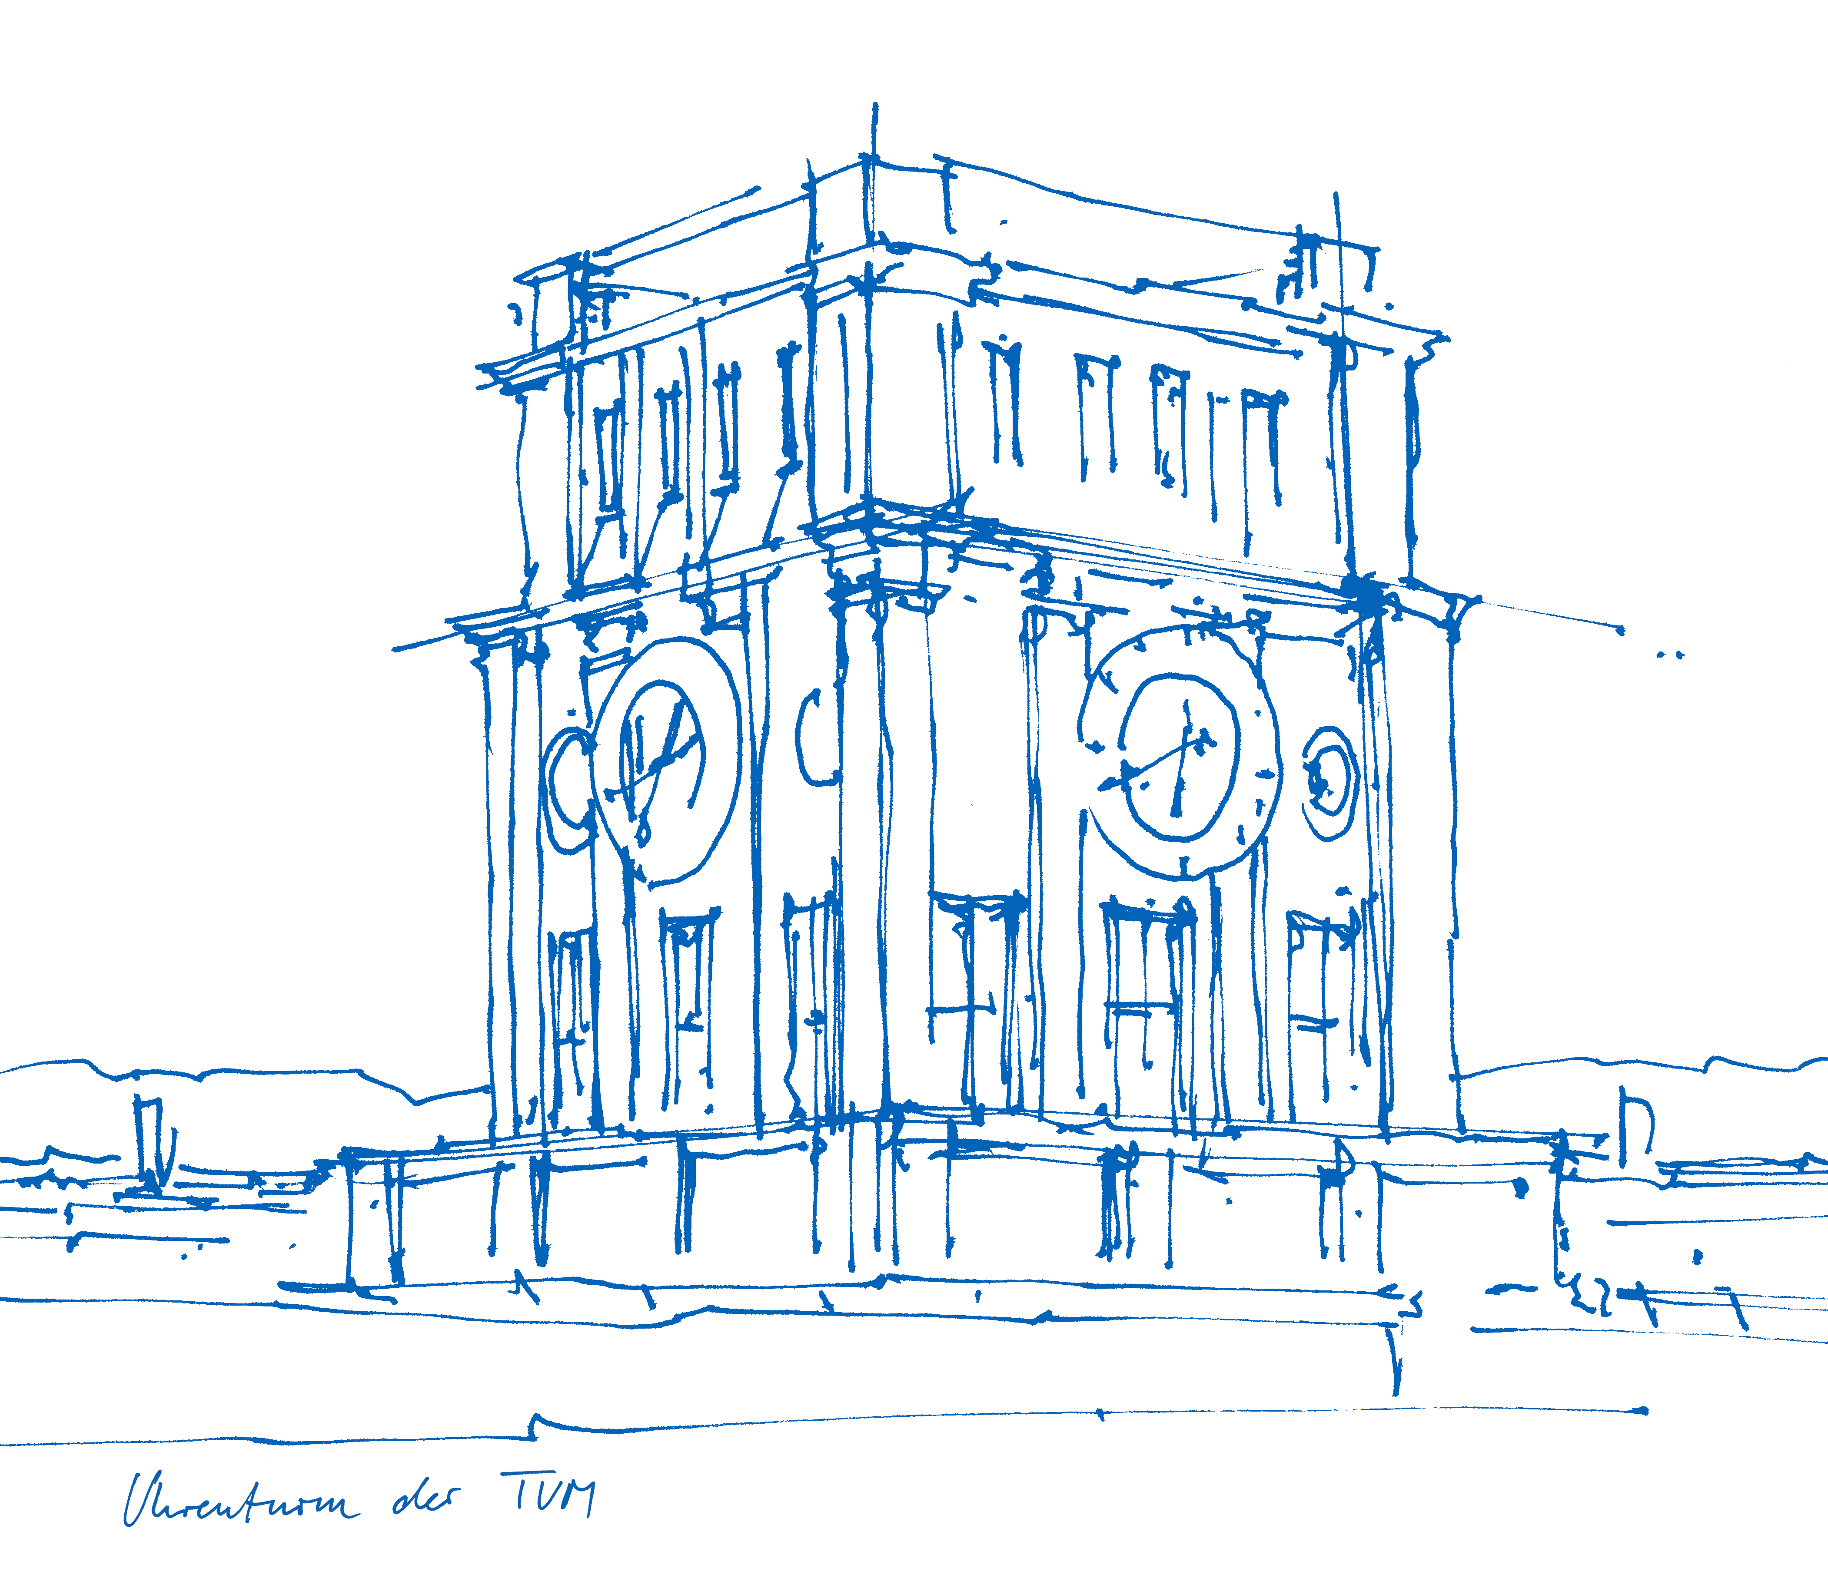
GoGo NAO: Dancer
Humanoid Robotic Systems
Behind a Successful NAO, there stand 3 Women!
Jun You, Jiaxin Yang, Lisa Gan
Chair for Cognitive Systems
Prof. Dr. Gordon Cheng
Munich, 03. February 2022
Notes:
1

Slide 2
Summary
Main Idea
Applications
System Architecture
Subtasks
Entry, Dance, Rose Grab, Pick Up Prop
Lessons learnt
Prof. Gordon Cheng (TUM)
2

Slide 3
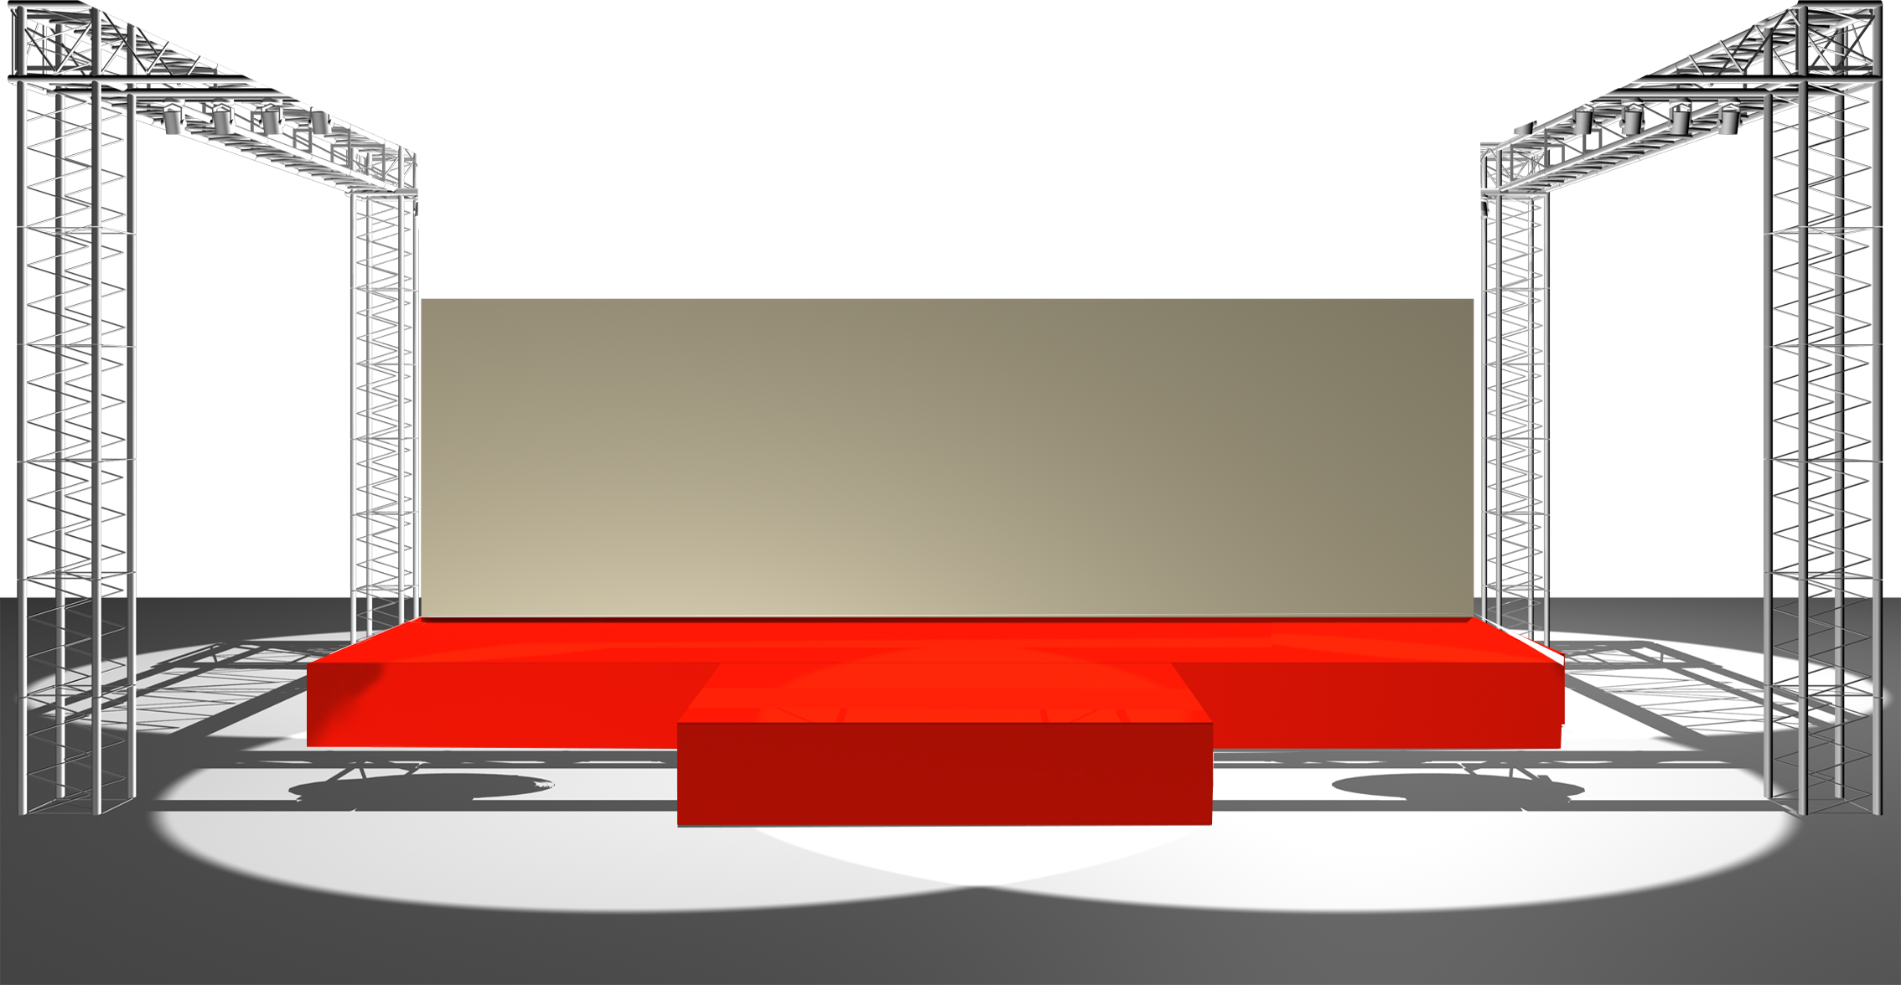
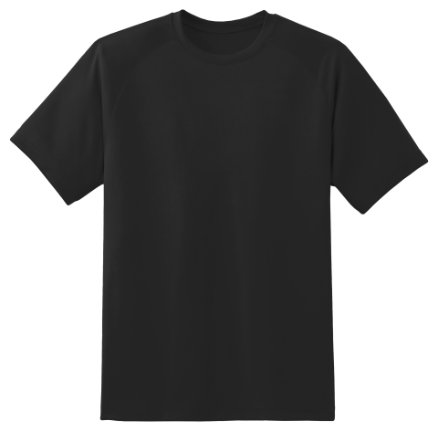
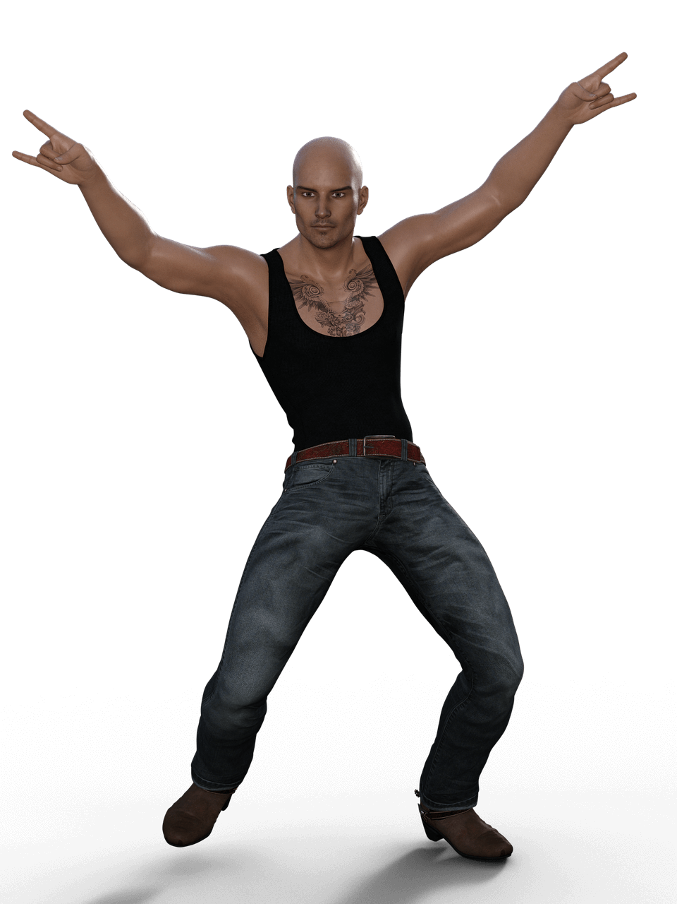
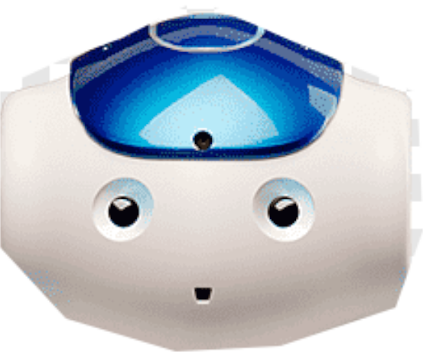
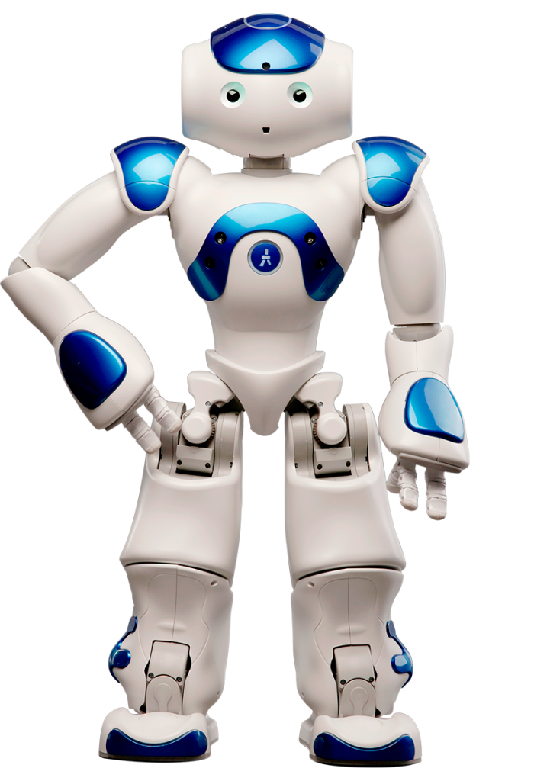

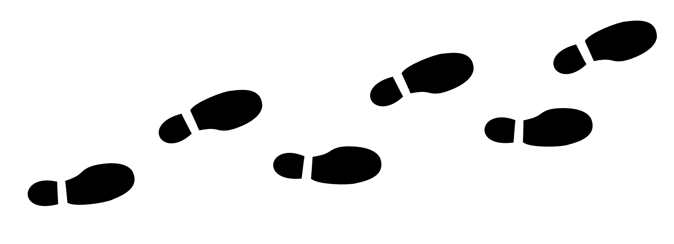

Main Idea

Slide 4
Applications
Pre-Shows for Conventions
Parties (University, School, Birthday etc.)
Waiting room entertainment
Dance instructor and motivator
At home: entertain children and teach interactions
Therapy: help children with autism
In School: introducing humanoid robots to students

Slide 5
System Architecture
Reactive architecture
System
Walk to Stage
NAO
Dance
Sense
Grab Rose
Throw Rose
Pick Up Prop
Leave Stage

Slide 6


Walk to Stage
Find Audience
Top camera + face recognition and tracking algorithm
ALFaceDetection ::learnFace() ALFaceDetection::getLearnedFacesList()
ALFaceDetection API
Walks towards audience → stands in front of audience
Top Camera
Face Recognition
Found Audience?
Walk towards Audience
Notes:
1.5 minutes

Slide 7
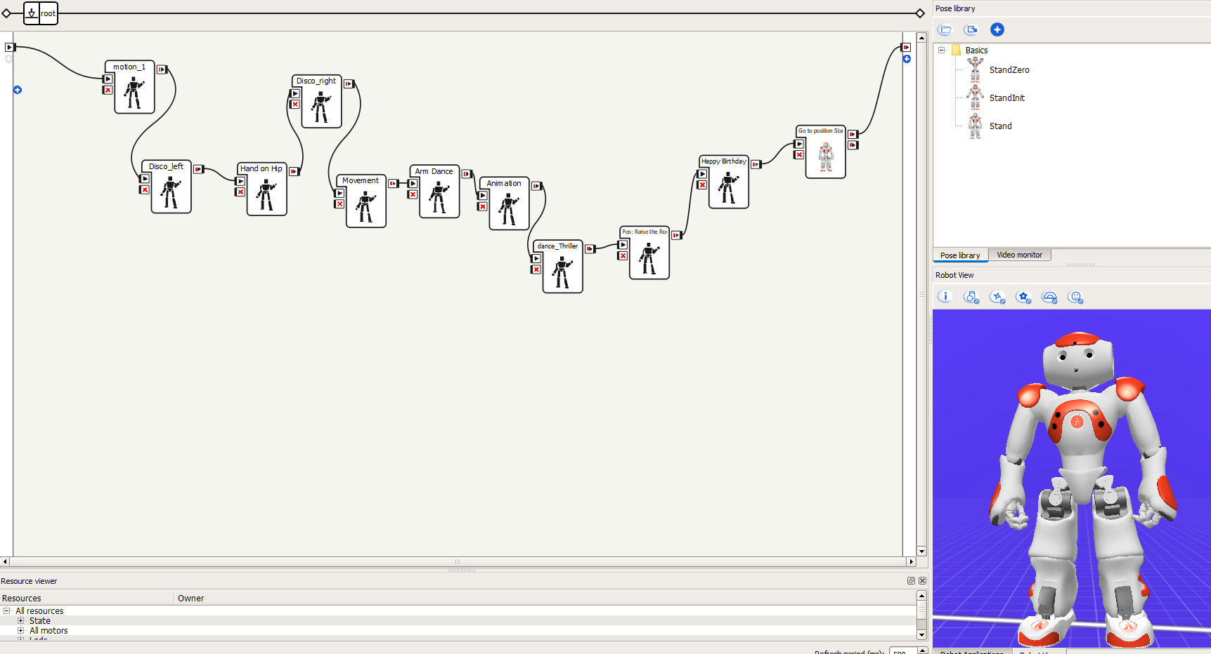
Dance
Choregraphe by Softbank Robotics to choreographe routine
Dance moves from F.U.N Lab of the University of Notre Dame
Call pre-uploaded behaviours in dance services
Notes:
Jun
1
Movement control*2
chhoregraphe

Slide 8
Dance
3 different dance routines with props
Disco (hat), Robot, Exotic Dancer (shirt)
Select a routine by speech recognition
Vocabulary of 4 words: „Disco“, „Robot“, „Exotic“, „Quit“
Disco Routine
Robot Routine
Microphone
Speech Recognition
Detect Instruction?
Exotic Dancer Routine
Quit
Notes:
Jun
1.30~~2
3 designed routine, how does it work
Technical details:
ALSpeechRecognition API: recognition, return a value of confidential
Fall Management API: fall manager API, Robothasfallen -> recover

Slide 9
Grab Rose
Marker Detection and Search()
Face Detection API to find Audience
Bottom Camera
ArUco Marker Detection
Found Rose?
Walk towards Rose
Grab Rose
Throw Rose
Find Audience
Face Detection
Notes:
Jun
2
Marker
Cartesian control: intuitive for users
ALFace_detection API: get camera direction and face to it

Slide 10
Pick Up Prop
Blob detection algorithm
Transfer 2d position to 3d position using floor projection
Top Camera
Blob Detection
Found Prop?
Walk to Prop
Pick Up Prop
Notes:
Jiaxin
2min

Slide 11
Lessons Learnt
3D face detection was not implementable
Inaccurate hand coordination of NAO
Weak grasp ability of NAO
Incapable of walking straight
Instable cable connection
Some restrictions due to physical damage of NAO
First experience with a humanoid robot
Fun project and great teamwork!

Slide 12

Thank you!
When GoGoNAO can‘t do THAT stripper move, because someone broke its arm:
Questions?

